Slide 1
Reproducibility: Why It Matters for Business
Stuart Buck
Vice President of Research, Arnold Ventures
http://StuartBuck.com

Slide 3
Why are we here?
1. Reproducibility crisis in science
2. What it means for you

Slide 4
To Whom Does This Matter?
If you:
Run experiments on marketing materials, websites, etc.;
Analyze data on past hires to figure out whom to interview in the future;
Analyze data to do market segmentation, determine credit risks, etc.;
Have any direct reports who do the above;
You need to be given accurate and reproducible information.

Slide 5
Unfortunately, there are many ways that inaccuracy and irreproducibility can creep in.

Slide 6
A simple taxonomy
 | SAME METHODS/CODE | DIFFERENT METHODS/CODE
SAME DATA | Verifiability | Robustness
DIFFERENT DATA | Repeatability [replication] | Generalization

Slide 7
Verifiability [same data, same methods/code]
This should be really straightforward.
Should.

Slide 8
But sometimes it’s not.

Slide 9
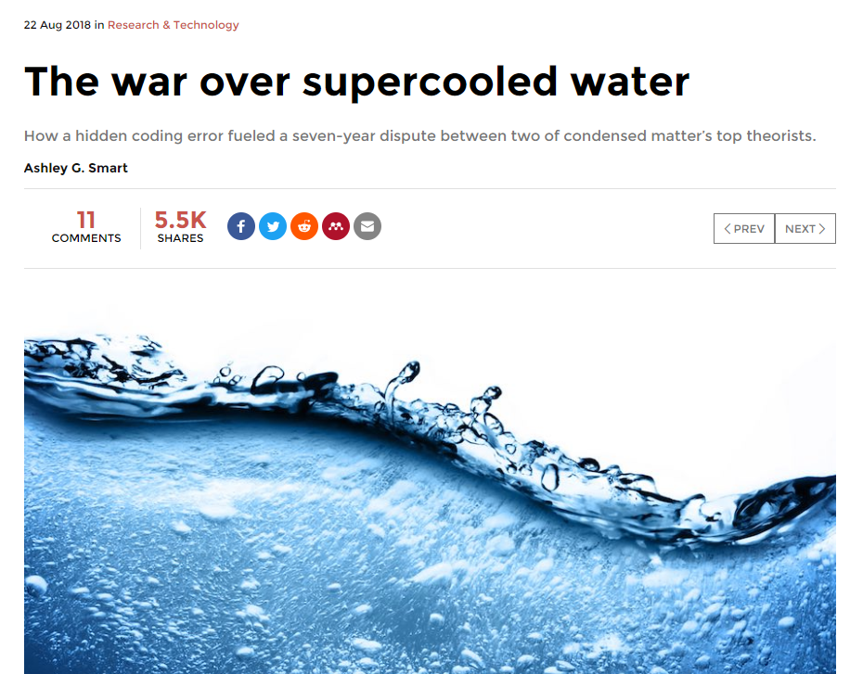
Notes:
https://physicstoday.scitation.org/do/10.1063/PT.6.1.20180822a/full/#.W32FOPvzIcQ.twitter
Debate between David Chandler at Berkeley and Pablo Debenedetti at Princeton. Debate was about how water molecules behave when super-cooled around the transition state between liquid and ice at the homogeneous nucleation temperature
“Then it was just a matter of testing each one, a process that took Palmer, Debenedetti, and their team of coworkers a few months. By summer, they had pinpointed the error.
As it turned out, the trouble stemmed from the algorithmic trick the Berkeley team had used to speed up its code.”

Slide 10
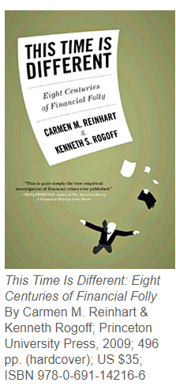
Famous Harvard economists
Widely influential book
Mistakes in a rudimentary Excel chart
Notes:
‘The most serious was that, in their Excel spreadsheet, Reinhart and Rogoff had not selected the entire row when averaging growth figures: they omitted data from Australia, Austria, Belgium, Canada and Denmark.
In other words, they had accidentally only included 15 of the 20 countries under analysis in their key calculation.
When that error was corrected, the “0.1% decline” data became a 2.2% average increase in economic growth. So the key conclusion of a seminal paper, which has been widely quoted in political debates in North America, Europe Australia and elsewhere, was invalid.’

Slide 11
Notes:
Pete Warden of Google: “I can say with my hand on my heart, that machine learning is by far the worst environment I’ve ever found for collaborating and keeping track of changes.
To explain why, here’s a typical life cycle of a machine learning model:
A researcher decides to try a new image classification architecture.
She copies and pastes some code from a previous project to handle the input of the dataset she’s using.
This dataset lives in one of her folders on the network. It’s probably one of the ImageNet downloads, but it isn’t clear which one. At some point, someone may have removed some of the images that aren’t actually JPEGs, or made other minor modifications, but there’s no history of that.
She tries out a lot of slightly different ideas, fixing bugs and tweaking the algorithms. These changes are happening on her local machine, and she may just do a mass file copy of the source code to her GPU cluster when she wants to kick off a full training run.
She executes a lot of different training runs, often changing the code on her local machine while jobs are in progress, since they take days or weeks to complete.
There might be a bug towards the end of the run on a large cluster that means she modifies the code in one file and copies that to all the machines, before resuming the job.
She may take the partially-trained weights from one run, and use them as the starting point for a new run with different code.
She keeps around the model weights and evaluation scores for all her runs, and picks which weights to release as the final model once she’s out of time to run more experiments. These weights can be from any of the runs, and may have been produced by very different code than what she currently has on her development machine.
She probably checks in her final code to source control, but in a personal folder.
She publishes her results, with code and the trained weights.
This is an optimistic scenario with a conscientious researcher, but you can already see how hard it would be for somebody else to come in and reproduce all of these steps and come out with the same result. Every one of these bullet points is an opportunity to inconsistencies to creep in.

Slide 12
To quote Pete Warden:
“If a researcher gets hit by a bus founds their own startup, somebody else should be able to step in the next day and train all the models they have created so far, and get the same results.”

Slide 13
How Do We Solve This?
Many companies have best practices in software development (version control, unit testing, using same conventions, etc.).
Notes:
https://dataconomy.com/2017/07/10-rules-results-data-science/

Slide 14
How Do We Solve This?
We need best practices for data analysis.
Preserve an unaltered raw dataset in a central location;
Script all data transformations and analysis (no “point and click”)
Document (perhaps in a virtual machine) all software versions and dependencies
Preserve random seeds
Notes:
https://dataconomy.com/2017/07/10-rules-results-data-science/

Slide 15
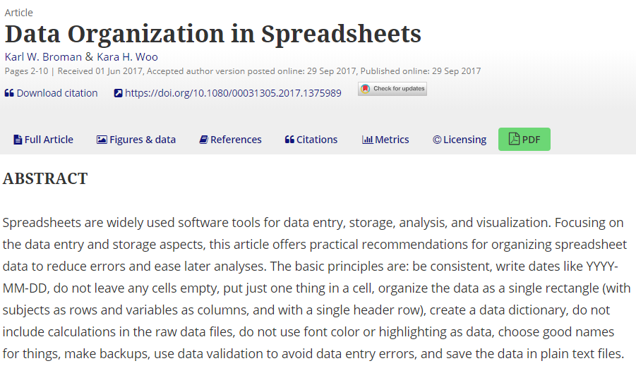
Or if you MUST use Excel:

Slide 16
Repeatability
 | SAME METHODS/CODE | DIFFERENT METHODS/CODE
SAME DATA | Verifiability | Robustness
DIFFERENT DATA | Repeatability [replication] | Generalization

Slide 17
Repeatability [replication, reproducibility]
You start with the same question/methods/code, but you collect new data or run a new experiment

Slide 19
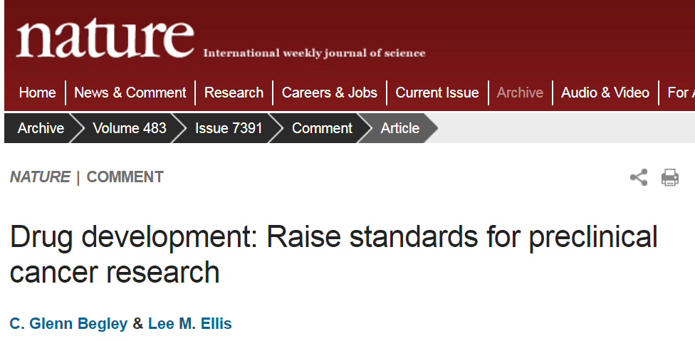

Slide 21
Notes:
From Zuckerberg’s essay:
To imagine what a future education system might look like, consider the research of Benjamin Bloom showing that if you take an average student and give them one-to-one tutoring, they will perform two standard deviations better than other students learning by conventional techniques. In other words, if a student is at the 50th percentile in their class and they receive effective one-on-one tutoring, they jump on average to the 98th percentile.
That suggests we need an education system where all students receive the equivalent of an expert one-on-one tutor. That is what we mean when we refer to "personalized learning". Rather than having every student sit in a classroom and listen to a teacher explain the same material at the same pace in the same way regardless of a student's strengths, learning style and interests, research shows students will perform better if they can learn at their own pace, based on their own interests, and in a style that fits them.

Slide 23
Is this finding repeatable in new data?
No.
More typical: Recent RCT from New York City involving tutoring in reading.
Effect: 0.09 standard deviations per year.
TWENTY-TWO TIMES SMALLER than the effect that Mark Zuckerberg was citing from an obscure 1984 study.
Notes:
https://scholar.harvard.edu/fryer/publications/high-dosage-tutoring-and-reading-achievement-evidence-new-york-city%E2%88%97

Slide 24
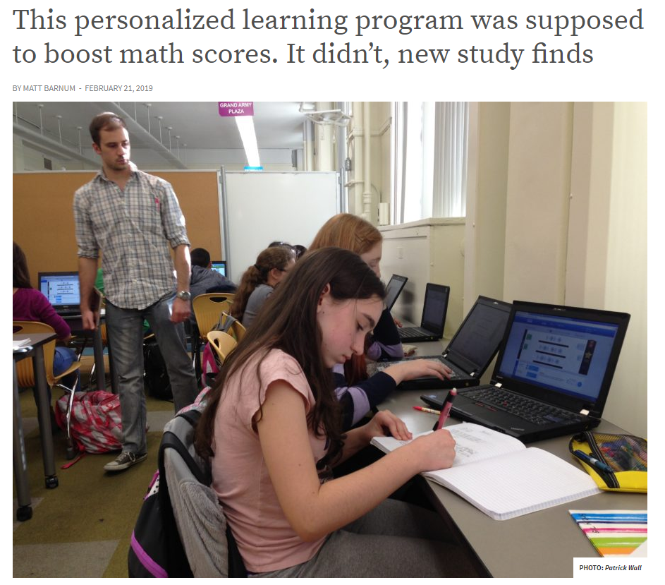
Notes:
https://www.chalkbeat.org/posts/us/2019/02/21/teach-to-one-study-math-scores/

Slide 25
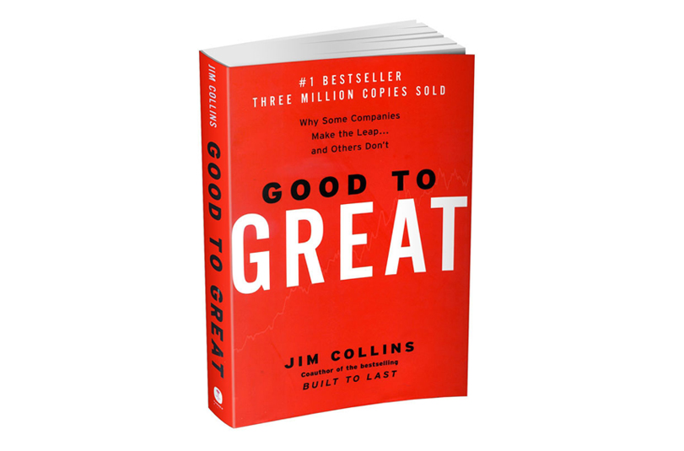

Slide 26
Repeatability
Even by 2008 – seven years after publication – critics pointed out that hardly any of the 11 companies highlighted in Good to Great had continued to do well in the stock market. Some had lost over 80% of their value.
Neindorf and Beck (Academy of Management Perspectives, 2008):
“Good to Great provides no evidence that applying the five principles to other firms or time periods will lead to anything other than average results.”

Slide 27
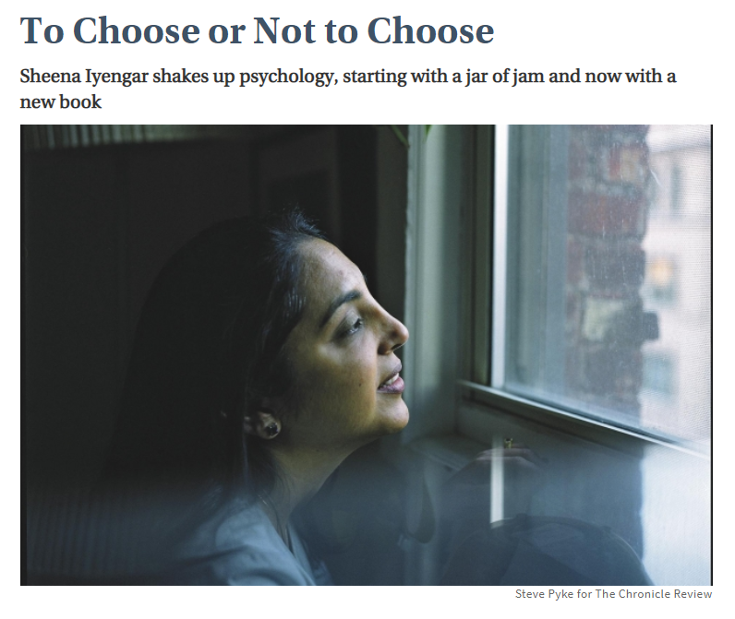
Notes:
This is a 2010 article profiling Sheena Iyengar. Iyengar, now a professor of business at Columbia University and author of the new book, The Art of Choosing (Twelve), decided to investigate. She persuaded the store manager to let her set up a tasting booth near the entrance. Every few hours, the booth alternated between offering samples of six and 24 flavors of jam. The results were startling: The table with 24 attracted more visitors but the table with six jams prompted a greater proportion of people to buy (30 percent of those who stopped at the six-flavor booth bought a jar, while only 3 percent at the 24-flavor booth made a purchase).
Intrigued, Iyengar and her adviser, Mark R. Lepper, devised a series of studies that replicated the problem of too much choice. In one experiment, subjects were asked to pick from among six types of Godiva chocolate, while another group chose from among 30 varieties. Those who were given more options were less satisfied with their decisions.
The findings, published in 2000 in the Journal of Personality and Social Psychology,

Slide 28
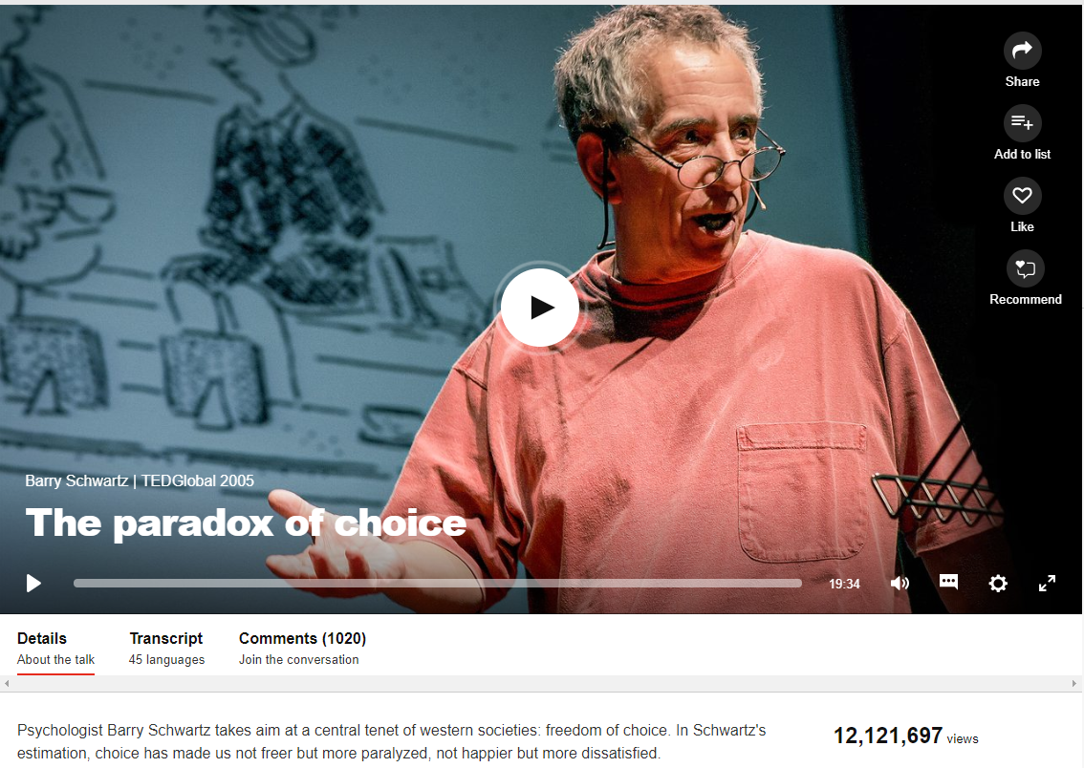

Slide 29
Notes:
From a meta-analysis of over 50 studies. Average effect of “more choice” was zero. That said, you can see lots of variation. https://digitalwellbeing.org/wp-content/uploads/2015/01/ScheibehenneGreifenederTodd2010.pdf
A 2015 meta-analysis of 99 studies on choice overload found that it DOES matter after all, but only under 4 conditions:
When consumers are just looking for a quick purchase without having to think about it.
When the decision is difficult due to things like poor presentation, lack of information, etc.
When the options are complex (e.g., multiple health insurance plans).
When customers don’t really know their own preferences

Slide 30
Notes:
Clayton Christensen, whose theory of “disruptive innovation” has led to multiple bestsellers in the business world. The Economist called the theory “one of the most influential modern business ideas.” Christensen and his associates have proposed disruption as a framework for thinking about vexing social problems such as poverty, lack of access to health care, illiteracy, and unemployment.

Slide 31
Notes:
The new Sloan Management Review paper, "How Useful Is the Theory of Disruptive Innovation?" by King and Baljir Baatartogtokh, a graduate student at the University of British Columbia, finds that only 9 percent of the 77 case studies that Christensen and his co-authors have presented as examples of disruption actually show all four of the features that supposedly define a disruptive event. (Those four qualities were: Incumbents were successful at sustaining innovation in their own target market; that innovation "overshot" the needs of a substantial number of customers; the incumbents had the capability of responding to the challenge from a newcomer; and the incumbents floundered afterward.) Fully 39 percent of the time, for instance, incumbents survived or even thrived after being disrupted, King and Baatartogtokh found. The authors' methodology was to interview experts in the field from which the case studies were drawn.
But Goldfarb says the theory has never been tested in anything like a rigorous way. "If you give Christensen all the benefit of the doubt, and say that his original study was factually correct — even if it was right, it doesn't make what he found a general fact about the world," Goldfarb says. "It makes it, at most, a fact about one industry. The next step would have been to replicate that study across many industries, with a reasonable sampling strategy that would tell us more about when it applies and when it doesn't. And under what conditions. And that's never been done. "
"Generalizing to the universe of industries based on the study of a single industry is simply wrong," Goldfarb said at the Academy of Management conference. A valid way to explore the theory's universality, he added, "would be to take several industries based upon certain criteria — say, high tech, low tech, manufacturing and services — and then explore the predictive validity of the theory of disruption across these industries. Instead, Christensen has assembled a series of case studies sampled on, as far as I can tell, incumbents losing to new entrants. When a case appears that does not comport, the strategy is to calibrate the theory to the data. This is a great strategy for lengthening the longevity of a theory but does not subject the theory to Popperian refutability." He goes further: It's a "fundamental violation of the scientific methodology.“
The same authors published a piece in Strategic Management Journal in 2015 in which they re-examined 300 papers in top journals, and estimated that between 24-40% were unreplicable.

Slide 32
Underlying Problems
Too much analytical flexibility
Non-representative samples
Too much flexibility to pick the positive results and leave everything else out
Notes:
Berman et al. (working paper, Dec. 2018):
Analyzed 2,101 commercial experiments, and found that a majority stopped collecting data just when the experiment reached statistical significance. This can wildly inflate the false positive rate.
Peterson and Merunka (Journal of Business Research, 2014): “Tests of theory in marketing and consumer behavior research are frequently based on convenience samples of undergraduate college students.”

Slide 33
How Do We Solve This?
Preregistration
Blinded analysis
Treat prior findings with appropriate skepticism
STOP REWARDING POSITIVE RESULTS

Slide 34
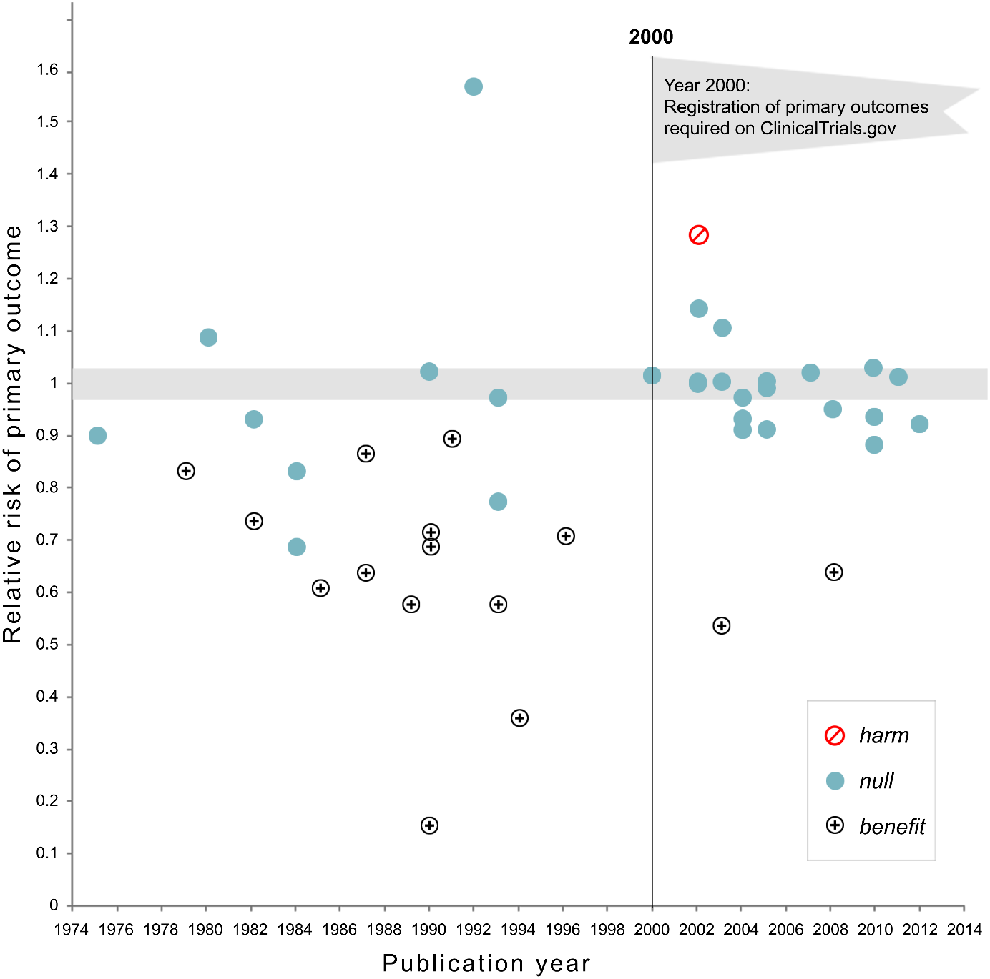

Slide 35
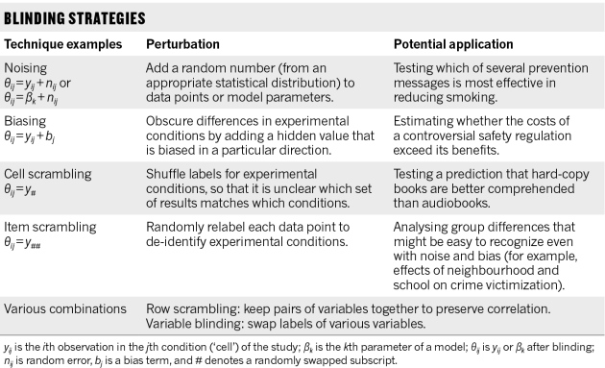
Notes:
Robert MacCoun & Saul Permutter, http://www.nature.com/news/blind-analysis-hide-results-to-seek-the-truth-1.18510

Slide 36
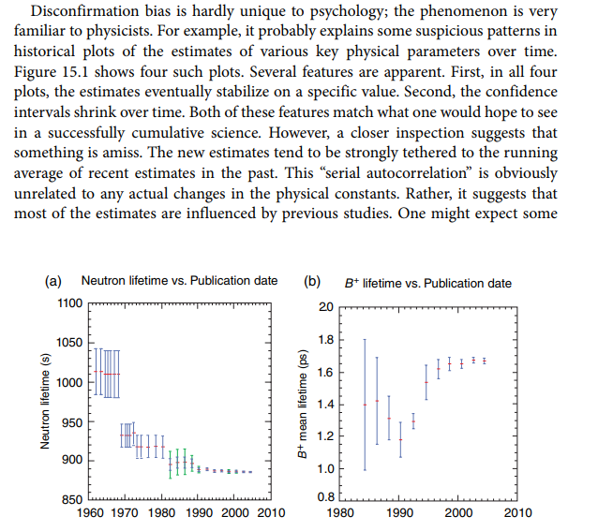
Notes:
Note that these are “one‐sigma” error bars, implying a 68% confidence interval (rather than the 95% confidence intervals that are conventional in psychology). If valid, any one of these confidence intervals would lead one to expect that almost a third of future estimates would fall outside the confidence region. Instead, successive estimates almost completely overlap.
Feynman (1985, p. 342) offers an account of why scientists took so long to correct the first reported estimate of the electron’s charge:
It’s a thing that scientists are ashamed of – this history – because it’s apparent that people did things like this: When they got a number that was too high above Millikan’s, they thought something must be wrong – and they would look for and find a reason why something might be wrong. When they got a number close to Millikan’s value they didn’t look so hard. And so they eliminated the numbers that were too far off, and did other things like that.

Slide 37
Robustness
 | SAME METHODS/CODE | DIFFERENT METHODS/CODE
SAME DATA | Verifiability | Robustness
DIFFERENT DATA | Repeatability [replication] | Generalization

Slide 38
Robustness [same data, new methods/code]
Key problem here: Even with the same data and the same question, there are many different ways to analyze it, to set up a statistical model, etc.

Slide 39
Notes:
This is from a paper called “Many Analysts, One Data Set,” published last year. 29 teams of analysts looked at the exact same data showing how often soccer referees handed out penalties. They were all asked to look at the exact same question: Were referees racially biased?
As you can see, several teams found basically no effect. A bunch of teams found a positive effect (positive meaning more penalties for black players), but the size of that effect varies anywhere from 1.03 to 1.48, 1.71, even for a couple of teams, an odds ration of nearly 3!

Slide 40
How Do We Solve This?
Multiple analyses

Slide 41
Notes:
From the journal Sociological Methodology (2018). http://journals.sagepub.com/doi/abs/10.1177/0081175018777988

Slide 42
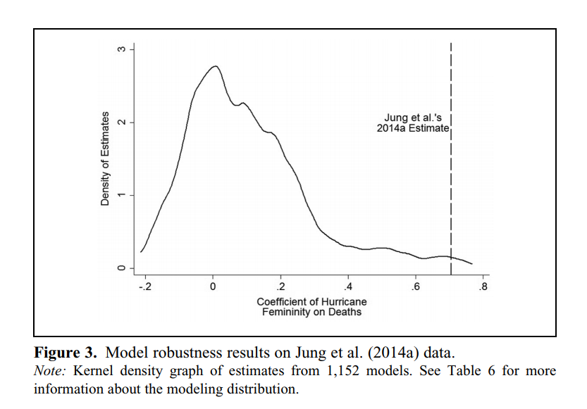

Slide 43
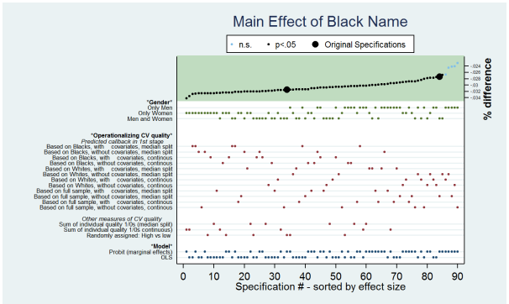

Slide 44
Generalizability
 | SAME METHODS/CODE | DIFFERENT METHODS/CODE
SAME DATA | Verifiability | Robustness
DIFFERENT DATA | Repeatability [replication] | Generalization

Slide 45
Generalizability [same question, new methods, new data]
THIS is what we all really want from research.
Not just to know what happens within a particular dataset using a particular method, but something broader

Slide 46
Generalizability [same question, new methods, new data]
It’s also extraordinarily hard to achieve.

Slide 47
Notes:
Out of roughly 500 treatments for stroke in animals, only aspirin and TPA worked in humans.

Slide 48
Generalizability [same question, new methods, new data]
Think about statistical models meant to predict fraud.
People adapt to any new model and figure out how to circumvent it.

Slide 49
Generalizability [same question, new methods, new data]
As companies like Uber and Opower found, it’s hard to generalize from one place to the next.
It’s even hard to generalize from one year to the next.
Google Flu Trends
Notes:
Originally, Google suggested that people’s searches could predict flu prevalence two weeks earlier than official statistics.
But just a few years later, that no longer worked. According to a 2014 paper in Science, Google Flu Trends “overshot the actual level in 2011–2012 by more than 50%. From 21 August 2011 to 1 September 2013, GFT reported overly high flu prevalence 100 out of 108 weeks.”

Slide 50
How Do We Solve This?
Run lots of experiments/analyses in different settings, time periods, populations, etc.
Try to incorporate more data so that over time you learn (if possible) about mechanisms -- whether there are any good predictors of when something works, for whom, where, why, etc.

Slide 51
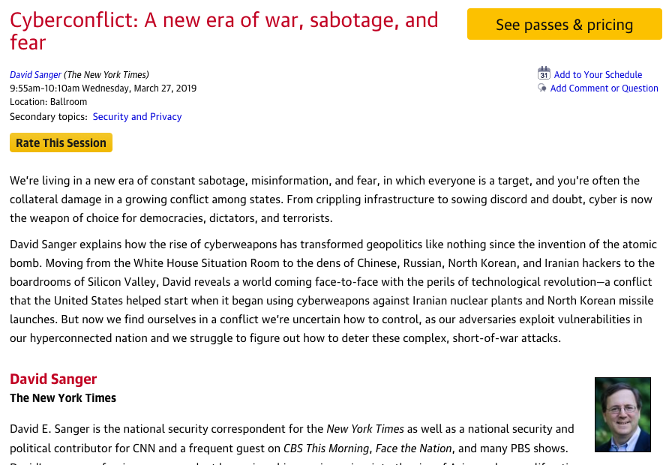
Rate today ’s session
Session page on conference website
O’Reilly Events App

